Slide 1
EMBEDDED IN AUTOMOBILES
BY
Mohammed shabbar
61828
Notes:
M.Dilip Gupta
10841A04A6

Slide 2
CONTENT
Definition
Embedded system components
Characteristics
Design process
Air bags
Abs
Automatic stability control

Slide 3
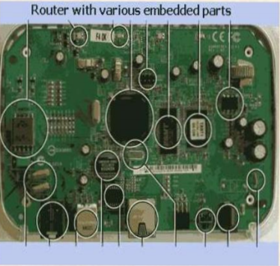
Embedded System- Definition?
“An embedded system is a
combination of hardware and
software which creates a
dedicated computer system
that performs specific, pre-defined tasks and which is
encapsulated within the
device it controls.
Notes:
Beginning course details and/or books/materials needed for a class/project.

Slide 4
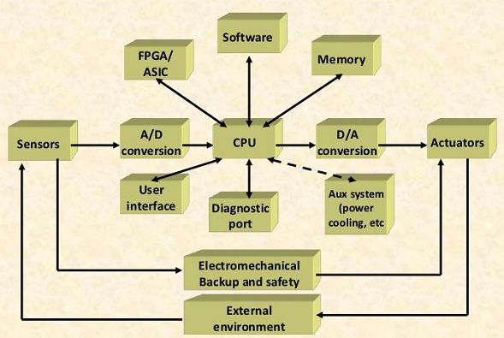
Embedded system components
Notes:
Beginning course details and/or books/materials needed for a class/project.

Slide 5
Characteristics of embedded systems
User Interface
Real-time operation
Low manufacturing cost.
Low power
Notes:
Beginning course details and/or books/materials needed for a class/project.

Slide 6
Design Process
Requirements
Specification
Components
System Integration
Architecture

Slide 7
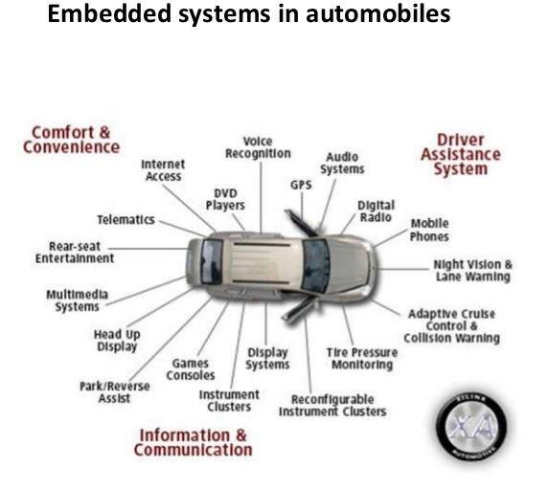
Automotive Systems: Technology in today's vehicle
Air Bags
Rain-sensing Wipers
Emission Control
Traction Control
Automatic Parking
Back-up collision sensor
Navigation Systems
Tire Pressure Monitor
Climate Control
Notes:
Beginning course details and/or books/materials needed for a class/project.

Slide 8
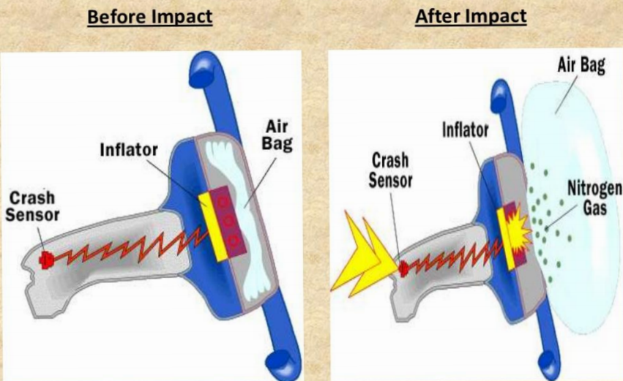
Air Bags : Principle of function
It is from the Newton's 2nd law of motion
AIR BAGS are among the most important safety improvements added to cars and light trucks in recent years, providing extra protection for front-seat occupants in head-on crashes.
And of late, every passengers protection.
Fig : Air Bag- Working
Notes:
Beginning course details and/or books/materials needed for a class/project.

Slide 9
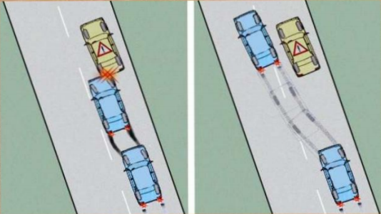
Anti-lock Braking System(ABS)
Up until the seventies, hitting the brakes too hard could lead to an accident.
On preventing wheel lock-up:
Reduces the total braking distance as far as possible
Increase vehicle stability
Without ABS
The vehicle in no longer steerable when driver hits the brake
With ABS
The vehicle remains steerable even during panic
Notes:
Beginning course details and/or books/materials needed for a class/project.

Slide 10
Principle of functioning of an ABS
The function of an anti-lock brake system is to minimize skidding by releasing brakes on wheels(it does so when wheels are moving slowly)
An ABS is placed between brakes and hydraulic pump
It uses sensor for each wheel ,so that the speed of the wheel can be measured,then these speed’s are used by the abs to identify the amount of hydraulic fluid pressure that need’s to be varied to reduce skidding
Notes:
Beginning course details and/or books/materials needed for a class/project.

Slide 11
Automatic Stability Control
The function of ASC+T system is to improve the stability of the car during its movement.
Gear shifting ,ignition timing ,throttle and different brake are the four system’s controlled by ASC+T system
It play’s an important role different tire snow’s operation.
This can be turned ON or OFF by the driver.
Notes:
Beginning course details and/or books/materials needed for a class/project.

Slide 12
Adaptive Cruise Control
Cooperative Adaptive Cruise Control with Collision Warning (CACC + CW)
CACC: Cruise at given speed when the road is clear (cruise control) otherwise follow the car in front, using radar (adaptive) and/or communications (cooperative).
CW: Warn the driver when an object is being approached too fast, or is too close
How it works :
Uses forward-looking radar, installed behind the grill of a vehicle, to detect the speed and distance of the vehicle ahead of it.
Can automatically adjust speed in order to maintain a proper distance between vehicles in the same lane
Notes:
Beginning course details and/or books/materials needed for a class/project.

Slide 13
Thank you

